Slide 1
Transport Layer

Slide 2
OSI transport layer
OSI model layer 4
TCP/IP model Transport layer
Application
HTTP, FTP, TFTP, SMTP etc
Presentation
Data stream
Application
Session
Transport
Segment
TCP, UDP
Transport
Network
Packet
IP
Internet
Data link
Frame
Ethernet, WAN technologies
Network Access
Physical
Bits

Slide 3
Transport vs. Network Layer
Household analogy:
12 kids in Dhaka sending letters to 12 kids in Khulna.
processes = kids
app messages = letters in envelopes
hosts = houses
transport protocol = Arif and Babar
network-layer protocol = postal service

Slide 4





Transport Services and Protocols
network layer: logical communication between hosts.
transport layer: logical communication between processes.
application
transport
network
data link
physical
network
data link
physical
network
data link
physical
network
data link
physical
logical end-end transport
network
data link
physical
network
data link
physical
application
transport
network
data link
physical

Slide 5
Primary Functions:
Segmenting and Reassembling segments.
Multiplexing segments.
Identifying and tracking the segments of different applications.
Establishing a connection before data transfer.
Error Control.
Flow control.

Slide 6
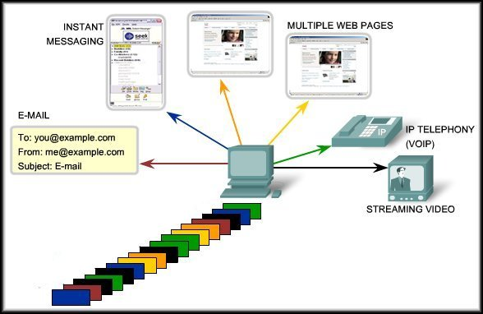
Segmenting Data
Application Layer passes large amounts of data.
Transport Layer breaks into smaller pieces called segments.

Slide 7
Segmenting and Managing Data
Multiplexing allows multiple, concurrent applications.
Segmentation allows multiplexing of the data from all sessions.

Slide 8
Reassembling Segments
Segment numbers allow reassembly of the data in the proper order.

Slide 9
Identifying Applications
After reassembly, the port number is used to pass the data to the correct application.
25
80
When created, each segment is assigned a unique application identifier.
(Port Number)
25

Slide 10
Initiating a Session
Transport layer provides for
connection orientation.
Allows the data to be closely managed.

Slide 11
Flow Control
Network hosts have limited resources.
(Memory, Bandwidth)
Regulating the amount that
can be transmitted or
received is flow control.

Slide 12
Error Control
It is possible for a piece of data to become corrupted or lost.
Transport layer protocols can request a retransmission.

Slide 13
Purpose of the Transport Layer
Primary responsibilities:
  Segmenting the data and reassembling the segments.
  Multiplexing segments.
  Identifying and tracking the different applications.
  Initiating a session between applications at two user ends.
  Error Control- Retransmission of lost and corrupted packets.
  Flow control – Controlling the data flow between sender and receiver.
Reliability

Slide 14
Reliability
To support these reliability operations, more control data is added in the Transport Layer header.
More extra functions are needed such as connection establishment etc.
These extra information and functions causes delay but ensures reliability.

Slide 15
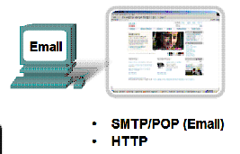
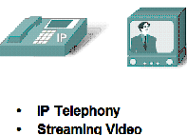
Different Applications
Different Requirements
Data needs to be complete with no errors or gaps
Slight delay is acceptable to ensure this.
Accept occasional errors or gaps in the data.
But delay is not acceptable.

Slide 16
Solution : Two transport protocols?
Reliable
TCP
Fast
UDP

Slide 17
Transport Layer Functions

Slide 18
Primary Functions:
Segmenting and Reassembling segments.
Multiplexing segments.
Identifying and tracking the segments of different applications.
Establishing a connection before data transfer.
Error Control.
Flow control.

Slide 19
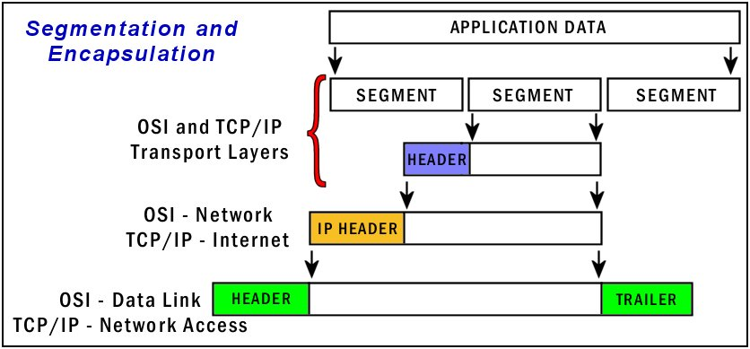
Segmentation and Reassembly

Slide 20
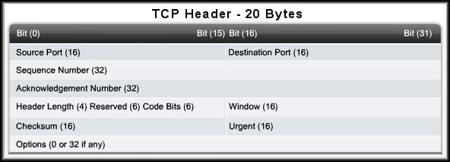
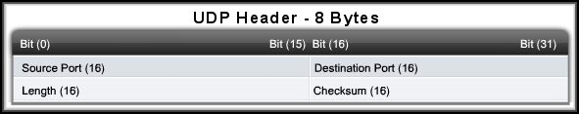
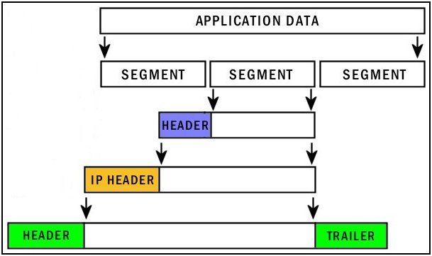
TCP and UDP Headers

Slide 21


TCP and UDP headers
TCP Header
UDP Header

Slide 22
Primary Functions:
Segmenting and Reassembling segments.
Multiplexing segments.
Identifying and tracking the segments of different applications.
Establishing a connection before data transfer.
Error Control.
Flow control.
PORT NUMBERS

Slide 23
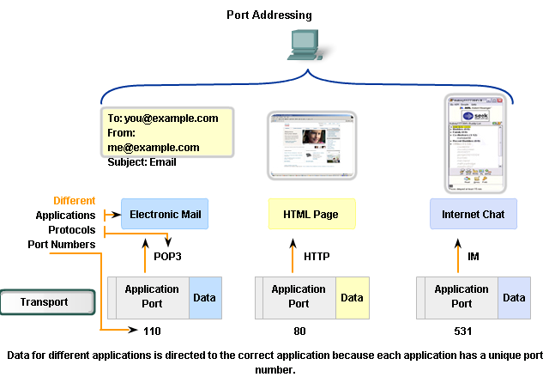
Port Numbers
Used by TCP and UDP as a form of addressing.
Identifies the application and the conversation.

Slide 24
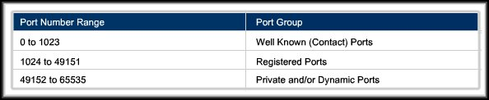
Port Numbers
Internet Corporation for Assigned Names and Numbers (ICANN) assigns port numbers.
Before that The Internet Assigned Numbers Authority (IANA) used to handle port numbers.

Slide 25
Port Addressing Types
Well-Known Ports:
  Reserved for common services and applications.
20 – FTP Data
443 – HTTPS
25 – SMTP
21 – FTP Control
69 – TFTP
110 – POP3
23 – Telnet
520 – RIP

Slide 26
Port Addressing Types
Registered Ports:
  Optional user processes and applications.
  Can be dynamically selected by a client as its source port.
8008 – Alternate HTTP
1863 – MSN Messenger
5004 – RTP
8080 – Alternate HTTP
5060 – SIP (VoIP)

Slide 27
Port Addressing Types
Dynamic Ports:
  Assigned to a user application at connect time.
Dynamic port usage will become clearer as we move through the material.

Slide 28
Port Addressing Types and Tools
Using both TCP and UDP:
  Some applications may use both TCP and UDP.
  For example, the low overhead of UDP enables DNS to serve many client requests very quickly.
  Sometimes, however, sending the requested information may require the reliability of TCP. In this case, the well known port number of 53 is used by both protocols with this service.

Slide 29
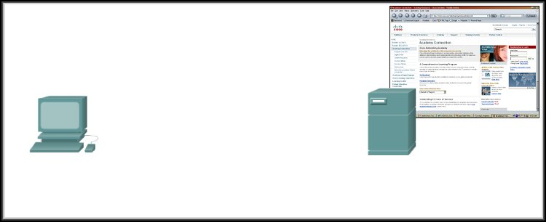
Transport Layer Server Processes
Source = 49650
Destination = 80
Client application uses a dynamic port to identify itself. (Dynamically generated)
All Web Servers runs the server side HTTP on Port 80.
The client sets the destination port to 80.

Slide 30
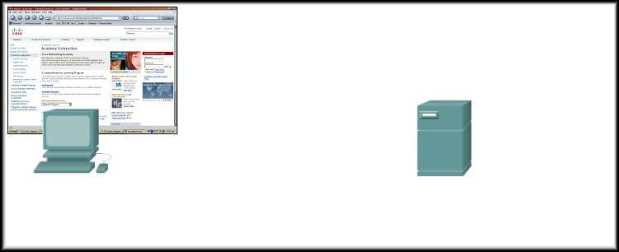
Transport Layer Server Processes
Source = 80
Destination = 49650
Server replies with the web page.
  Sets the source port to 80 and uses the client’s source port as the destination.

Slide 31
Transport Layer Server Processes
Source = 49650
Destination = 80
Source = 80
Destination = 49650
Notice how the source and destination ports are used.

Slide 32
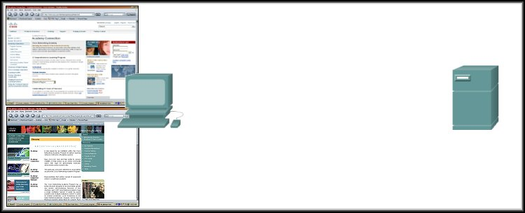
Transport Layer Server Processes
Source = 49650
Destination = 80
Source = 80
Destination = 49650
172.16.230.5
207.22.146.33
Source = 49655
Destination = 80
Source = 80
Destination = 49655
What if there are two sessions to the same server?
  The client uses another dynamic port as its source and the destination is still port 80.
  Different source ports keep the sessions unique.

Slide 33
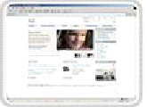


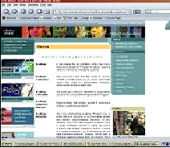
Socket Address
Source = 49650
Destination = 80
172.16.230.5
Source = 49650
Destination = 80
207.22.146.33
172.16.230.6
How does the Server’s Transport Layer keep them separate?
  The socket (IP Address:Port)
172.16.230.5:49650
172.16.230.6:49650
207.22.146.33:80
207.22.146.33:80

Slide 34
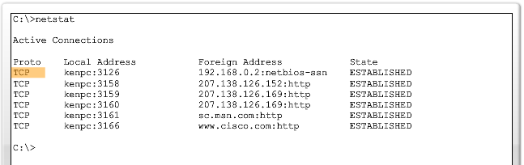
Netstat - Network Utility Tool
Source IP
Source Port
Destination IP
TCP/UDP
Destination Port
Source Socket
Connection State
Shows protocol, local address and port number, foreign address and port number.
Unexpected connections may mean there is a security problem.
Destination Socket

Slide 35
Primary Functions:
Segmenting and Reassembling segments.
Multiplexing segments.
Identifying and tracking the segments of different applications.
Establishing a connection before data transfer.
Error Control.
Flow control.
Performed only by TCP

Slide 36
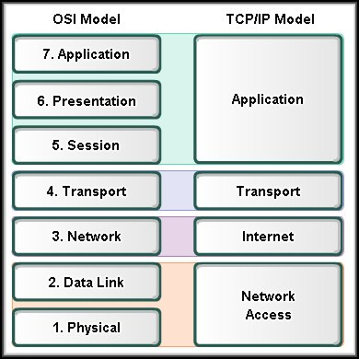
TCP
Communicating with Reliability

Slide 37
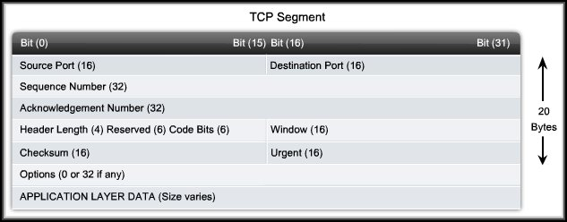
Transmission Control Protocol (TCP)
Connection-oriented
Reliable delivery
Error checking
Flow control
Example Applications
Hypertext Transfer Protocol (HTTP)
File Transfer Protocol (FTP)
Telnet
Simple Message Transfer Protocol (SMTP)

Slide 38
TCP - Header
TCP session that opened a connection. Usually a random value above 1023.
Upper Layer application on the remote site.
The number of the first
octet (byte) in the segment.
The number of the next octet (byte) expected by the receiver.

Slide 39
TCP - Header
Individual 1 bit fields used in session management.
The length of the segment header in bytes.
Flow control.
If the Urgent FLAG is set, the location of the urgent data.
Error checking the header.

Slide 40

Control/Flag/Code Bits
6 Bits
0 = OFF
1 = ON

Slide 41
TCP Functions:
Segmenting and Reassembling segments.
Multiplexing segments.
Identifying and tracking the segments of different applications.
Establishing a connection before data transfer.
Error Control.
Flow control.

Slide 42
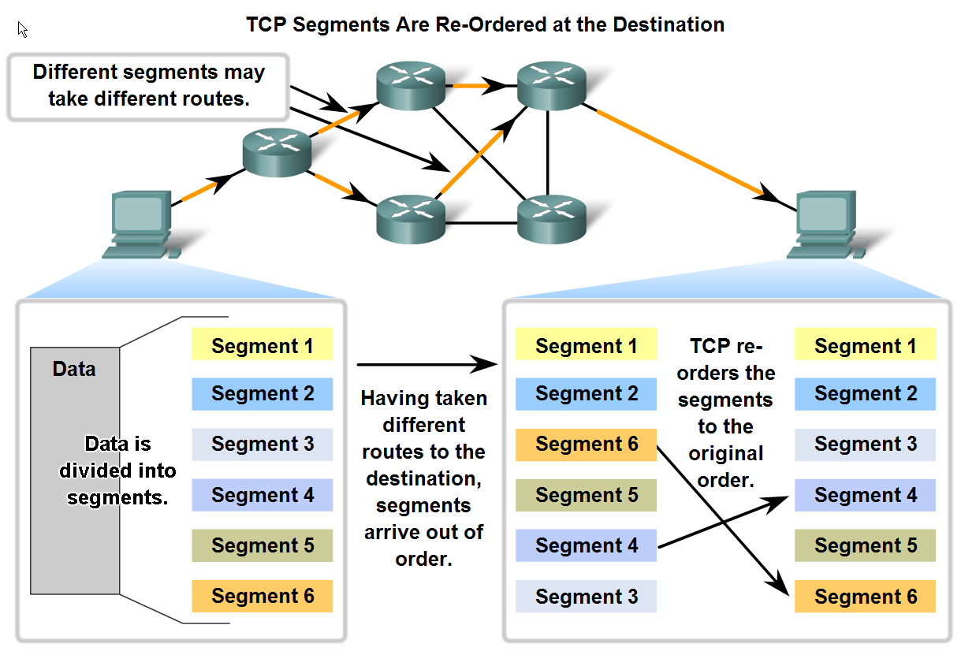
TCP Segment Reassembly
Sequence Number

Slide 43

Sequence Numbers
The number of the first data byte contained in that segment.

Slide 44
TCP Functions:
Segmenting and Reassembling segments.
Multiplexing segments.
Identifying and tracking the segments of different applications.
Establishing a connection before data transfer.
Error Control.
Flow control.

Slide 45
Connection Establishment
TCP sets up a connection between end hosts before sending data
This process is the Three-way handshake.
When data transfer is finished, the hosts send signals to end the session.

Slide 46


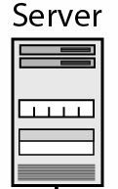
TCP Connection Establishment
“Three Way Handshake”
49152
80
Source Port No. |  |  |  |  |  | Destination Port No.
Sequence No.
Acknowledgement No.
 | U | A | P | R | S | F | Window Size
Others
 |  |  |  |  |  |  | Window Size
Others
49152
49152
80
80
49152
80
0
0
1
0
1
1
A
A
S
S

Slide 47
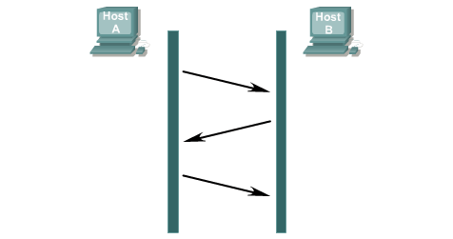
TCP Connection Establishment
“Three Way Handshake”
1
Send SYN
SEQ=100, CTL=SYN
Receive SYN
Send ACK and SYN
SEQ=300, ACK=101
CTL=SYN, ACK
2
Receive SYN
Established
Send ACK
SEQ=100, ACK=301
CTL=ACK
3

Slide 48
TCP Connection Termination
1
Send FIN
Receive FIN
2
Send ACK
Receive ACK
Send FIN
3
Receive FIN
Send ACK
4
Receive ACK

Slide 49
TCP Connection Termination
“Three Way Termination”
1
Send FIN
Receive FIN
Send ACK and FIN
2
Receive FIN
3
Send ACK

Slide 50
TCP Functions:
Segmenting and Reassembling segments.
Multiplexing segments.
Identifying and tracking the segments of different applications.
Establishing a connection before data transfer.
Error Control.
Flow control.

Slide 51
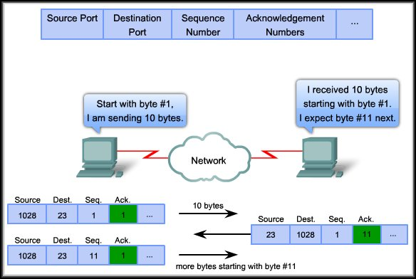
TCP Acknowledgements
Used together to confirm the receipt of data

Slide 52
TCP Acknowledgements
Expectational Acknowledgement
ACK = ISN + 1

Slide 53
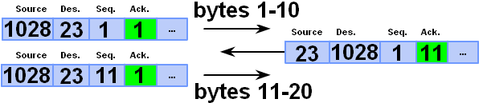
Expectational acknowledgement
If receiving host TCP receives uncorrupted data, then
It sends an acknowledgement giving the sequence number of the byte that it expects next.

Slide 54
TCP Data Transfer
49152
80
Source Port No. |  |  |  |  |  | Destination Port No.
Sequence No.
Acknowledgement No.
 | U | A | P | R | S | F | Window Size
Others
 |  |  |  |  |  |  | Window Size
49152
80
80
49152
0
1
400
400
1
601
A
A
P
P
0 bytes
0-399 bytes
1-600 bytes

Slide 55

TCP Data Transfer- Multiple Segments

Slide 56

TCP Data Transfer-Reliability

Slide 57
TCP Error Control
Packet Lost or Corrupted?
Retransmission of packet ??
How will the sender know ??
Send ARQs – Automatic Repeat Request.
What about the receiver, not aware of a packet sent?
Automatic Retransmission after time out.

Slide 58
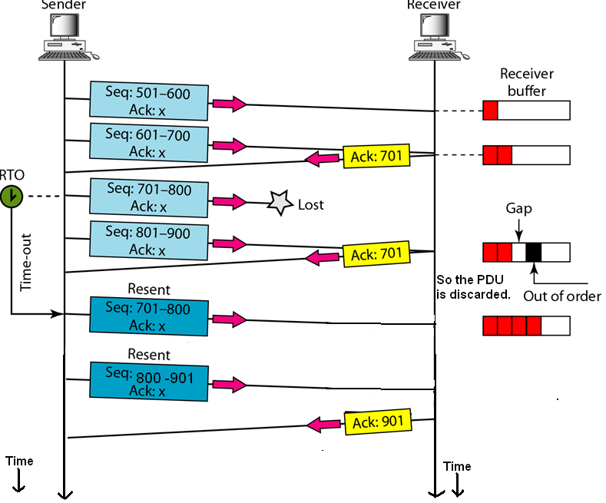
TCP Error Control- Go-Back –N ARQ

Slide 59

TCP Error Control- Selectively Reject ARQ

Slide 60
TCP Functions:
Segmenting and Reassembling segments.
Multiplexing segments.
Identifying and tracking the segments of different applications.
Establishing a connection before data transfer.
Error Control.
Flow control.

Slide 61
TCP Windowing
With a window size of 10
  Each segment carries only ten bytes of data.
  And must be acknowledged before another segment is transmitted.

Slide 62
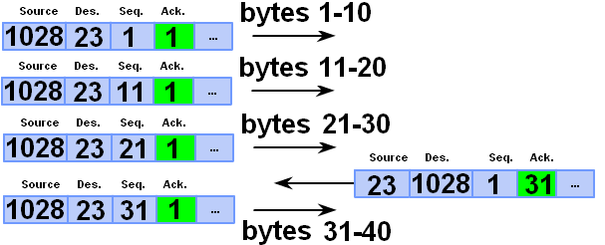
Window size
Controls how many bytes are sent before an acknowledgement is expected.
Window Size ?

Slide 63
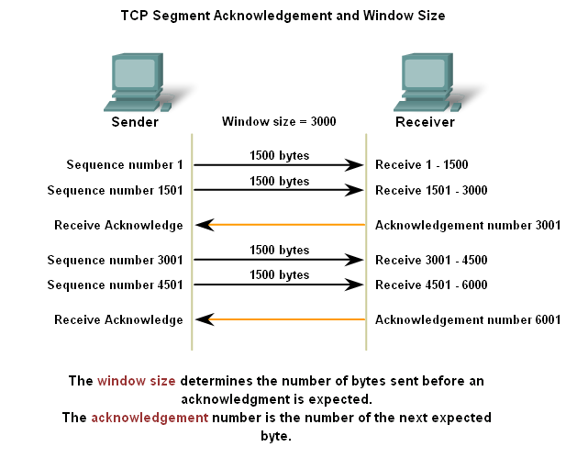
TCP Flow Control

Slide 64
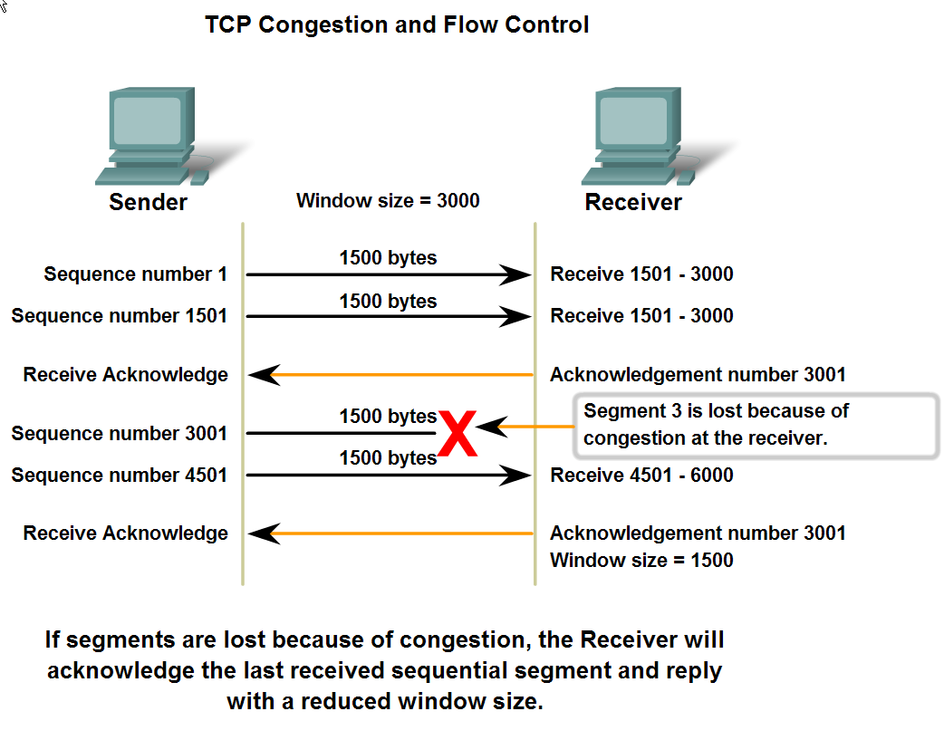
TCP Flow Control

Slide 65
Flow control
The initial window size is agreed during the three-way handshake.
If this is too much for the receiver and it loses data (e.g. buffer overflow) then it can decrease the window size.
If all is well then the receiver will increase the window size.

Slide 66
UDP
Communicating with No Reliability

Slide 67
User Datagram Protocol (UDP)
Connectionless
No reassembly to order.
No Error checking
No Flow control
Example Applications
Domain Name Service (DNS)
Trivia File Transfer Protocol (TFTP)
Dynamic Host Configuration Protocol (DHCP)

Slide 68
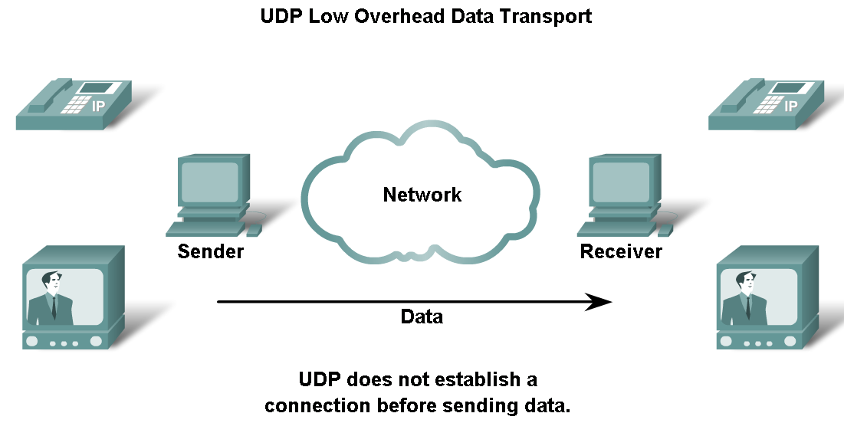
UDP
Connectionless

Slide 69
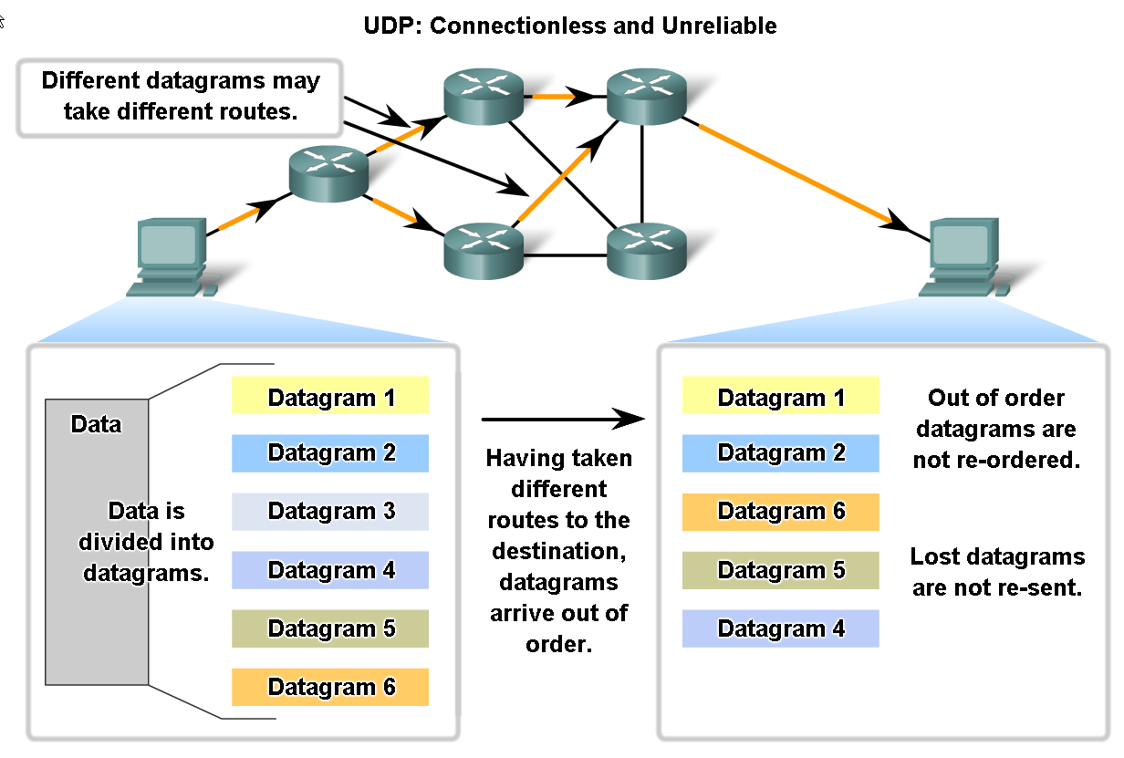
UDP
No reassembly at receiving end.

Slide 70
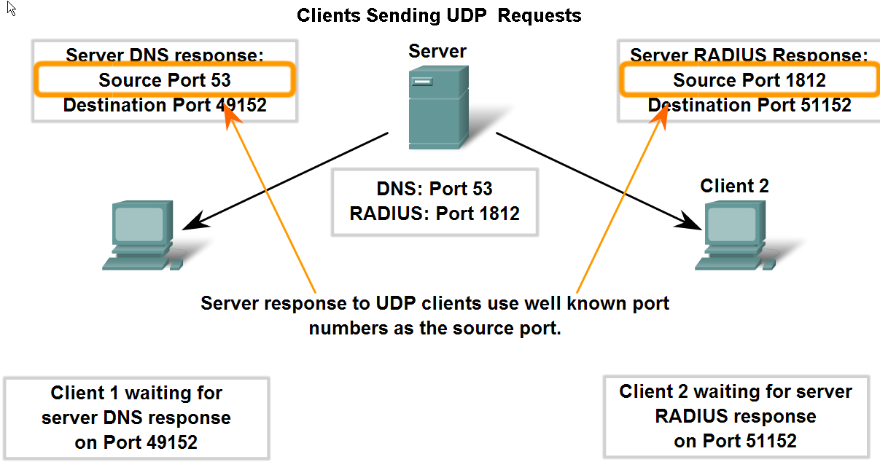
UDP Ports
Like TCP-based applications, UDP-based server applications are assigned Well Known or Registered port numbers.

Slide 71
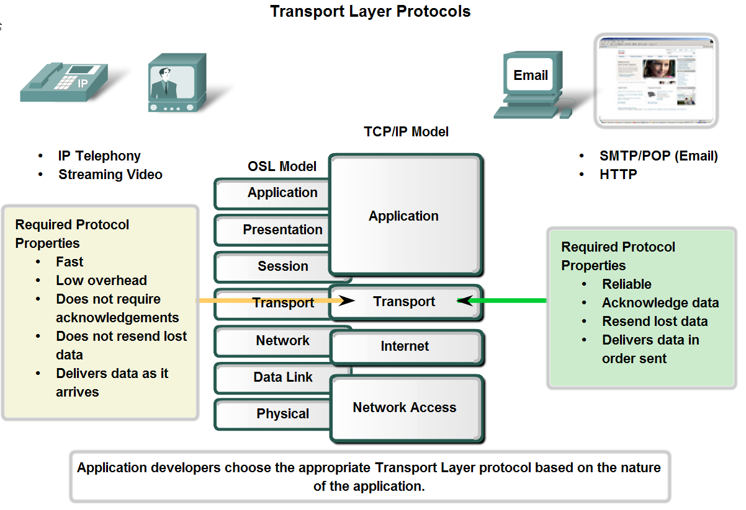
UDP versus TCP
UDP
TCP

Slide 72
TCP UDP
Sets up a connection with the receiving host before sending data.
Checks if segments have arrived and resends if they were lost. (Reliability)
Sorts segments into the right order before reassembling the data.
Sends at a speed to suit the receiving host. (Flow control)
High overhead (20 bytes header)
Used for Emails, Web Browsing etc.
Connectionless. Does not contact receiving host before sending data.
Does not check if data arrived and does not re-send. “Best effort”.
Does not sort into the right order.
No flow control.
Low overhead (8 bytes header)
Used for VoIP, streaming video, DNS, TFTP

Slide 73
The End

